Slide 1

Ingram Micro Poland Bartek
WATSON CHALLENGE 19.06.2024 Bartosz Winiarski, Bartosz Jarzynski, Michal Bochnacki

Slide 2
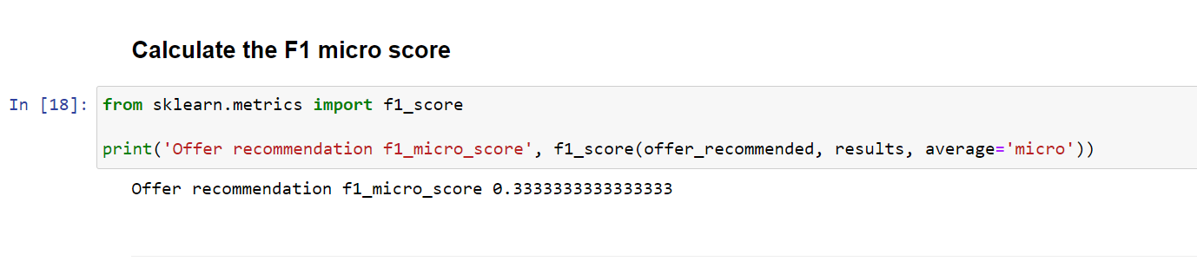
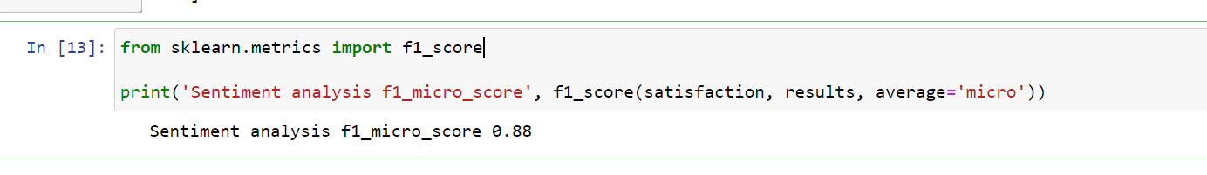
Deliverable: Output score

Slide 3
USE CASE RECOMMENDATION
How the watsonx product(s) could be leveraged to solve a new, real-world problem? We have developed a tool which, based on a conversation and a subsequent note after a meeting with a customer, helps the IBM salesman to assess whether the customer is interested in buying IBM products Decide if customer want to buy IBM products or not based on the given feedback by customer. Respond 1 if want and 0 if not.

Slide 4
VALUE OF THE IDEA/USE CASE
This tool will save salesmen at IBM a great deal of time. At the same time, it will allow deal volume and deal margins to increase. This tool is designed to maximise profits and minimise the time spent evaluating customer responses

Slide 5
HOW DOES IT WORKs?
The IBMer enters the meeting notes after the meeting into a prepared chatbot, which analyses the client's responses. Based on historical data, which we can confidently obtain from SalesForce etc. WatsonX assesses the chances of a solution being sold, where 1 means a 100% chance of a sale and 0 means a 0% chance of a sale. What's more. A given outcome helps the IBMer to assess the current situation and to position itself in a different negotiating position. This will save the time it takes to negotiate and increase the chances of winning the negotiation.

Slide 6
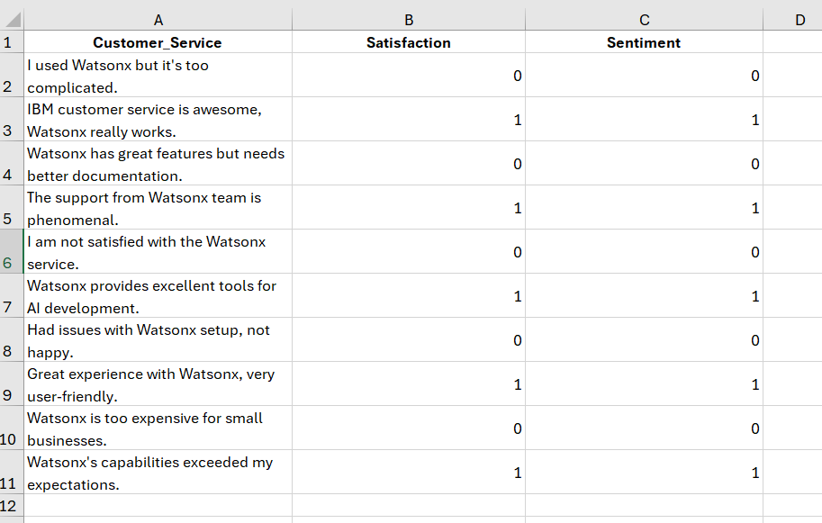
sample database

Slide 7
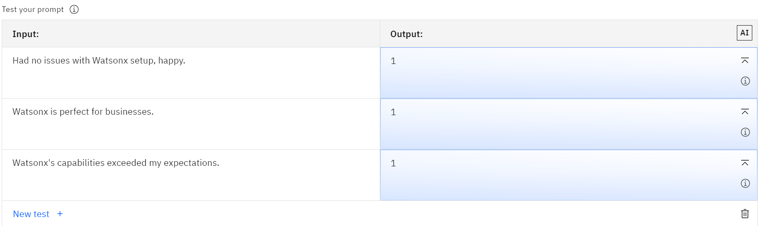
Examples

Slide 8

If you have any additional question… ask us… or…

